Slide 1
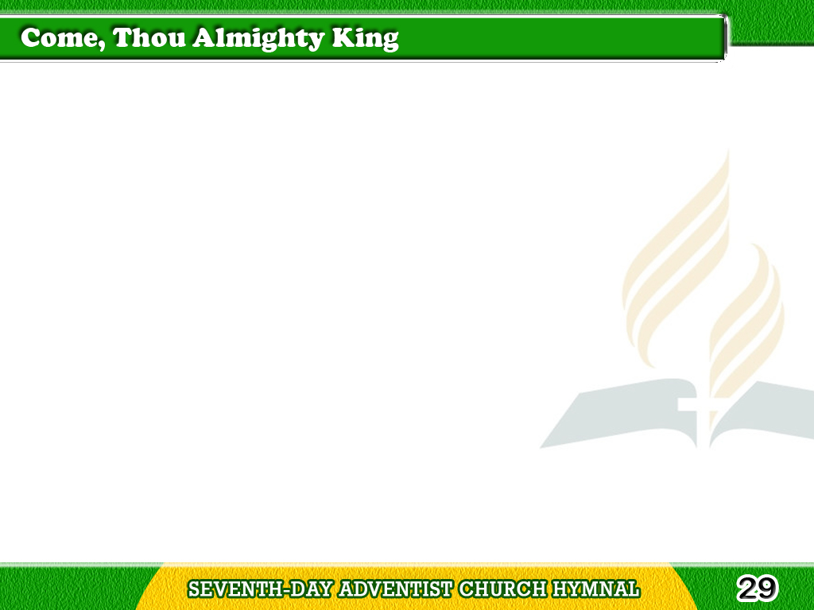
1/4
Come, Thou almighty King,
Help us Thy name to sing,
Help us to praise!
Tagalog
Version

Slide 2
1/4
Father all glorious,
O’er all victorious,
Come, and reign over us,
Ancient of Days!
Tagalog
Version

Slide 3
2/4
Come, Thou incarnate Word,
Gird on Thy might sword,
Our prayer attend;
Come, and Thy people bless,
Tagalog
Version

Slide 4
2/4
And give Thy
Word success;
Spirit of holiness,
On us descend!
Tagalog
Version

Slide 5
3/4
Come, holy Comforter,
Thy sacred witness bear,
In this glad hour:
Thou who almighty art,
Tagalog
Version

Slide 6
3/4
Now rule in every heart,
And ne’er from us depart,
Spirit of power!
Tagalog
Version

Slide 7
4/4
To Thee, great One in Thee,
Eternal praises be,
Hence, evermore:
Tagalog
Version

Slide 8
4/4
Thy sovereign majesty
May we in glory see,
And to eternity
Love and adore!
Tagalog
Version

